Slide 1
Brazil An. darlingi wings
Results and figures
10/15/2017

Slide 2
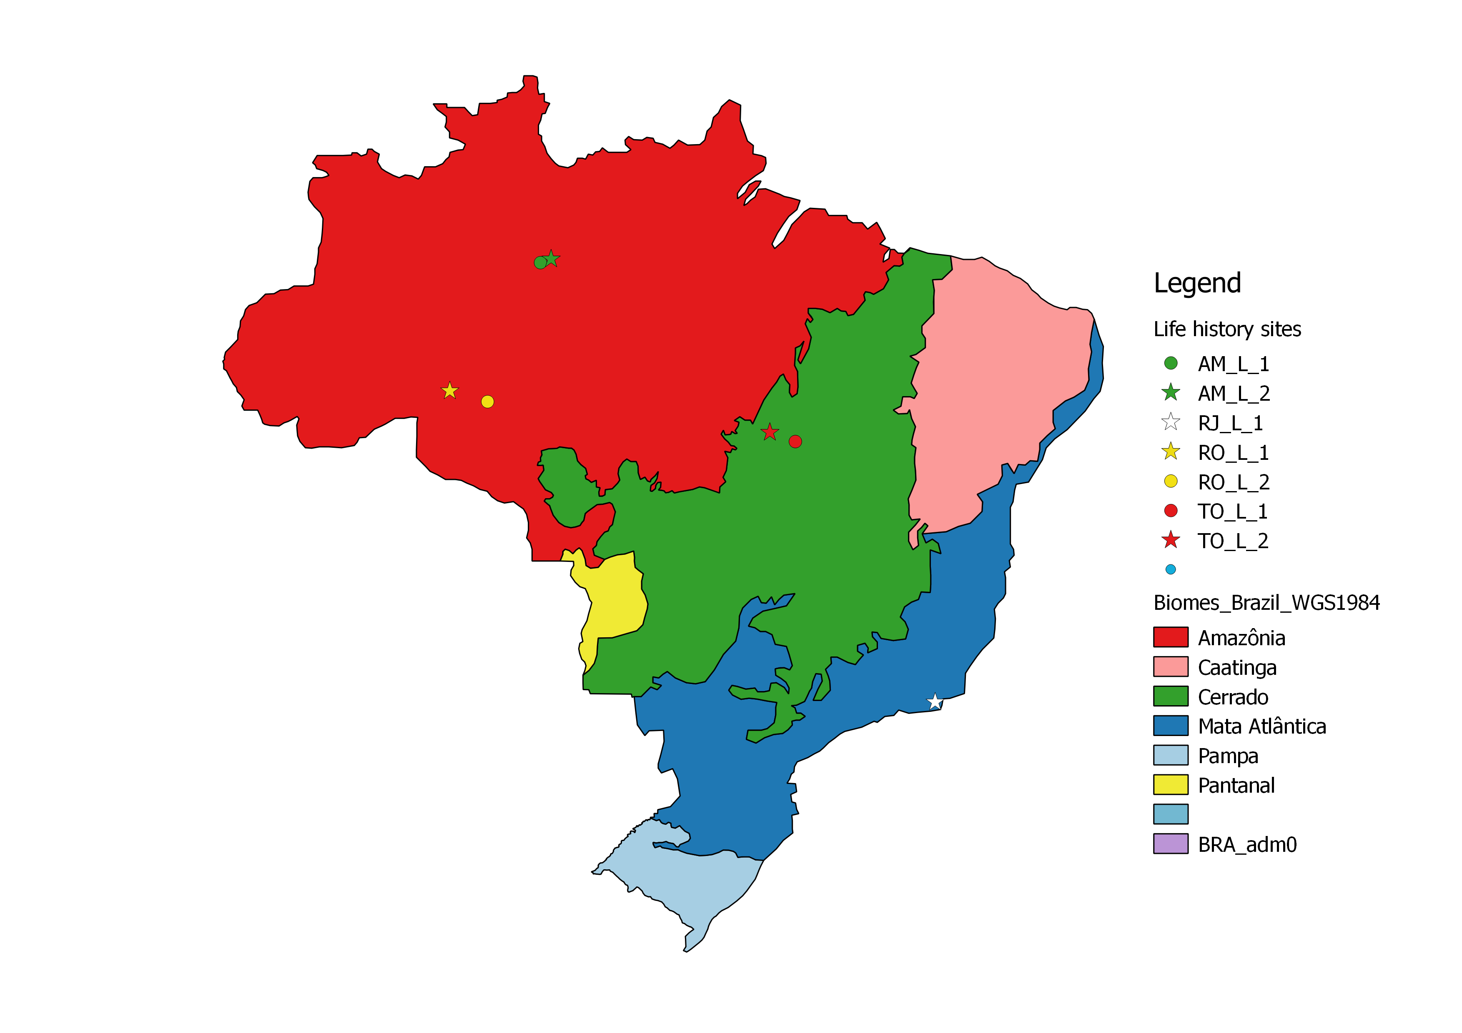
Map of field sites

Slide 3
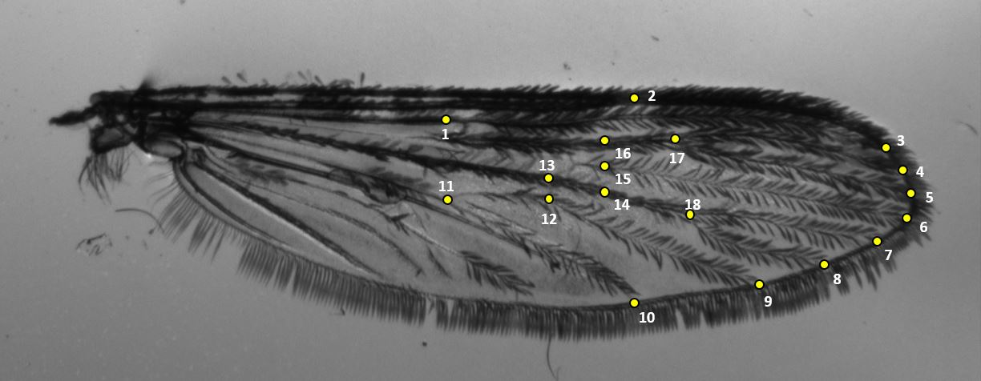
18 landmarks placement (Motoki 2012)

Slide 4
Preliminary data table
Biome | Locality | Latitude | Field (n) | Wing length (avg ± sd) | CS (avg± sd)
Amazon | ARS | -2.864 | 17 | 2.92 ± 0.2 | 2.7 ± 0.18
 | APR | -3.028 | 50 | 2.97 ± 0.18 | 2.75 ± 0.18
 | RPV | -8.742 | 47 | 2.95 ± 0.18 | 2.75 ± 0.16
 | RMO | -9.223 | 45 | 3.02 ± 1.8 | 2.83 ± 0.17
Cerrado | TLC | -10.7 | 54 | 3.09 ± 0.17 | 2.87 ± 0.15
 | TPN | -10.796 | 16 | 3.04 ± 0.17 | 2.89 ± 0.15
Mata Atlantica | SJU | -22.611 | 11 | 3.5 ± 0.1 | 3.26 ± 0.11

Slide 5
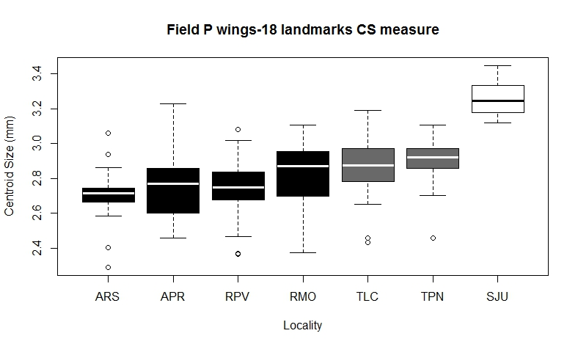
Centroid sizes by latitude
Legend
Amazon- Black
Cerrado- Gray
Mata Atlantica- White
Notes:
Done in R

Slide 6
Repeatability
Field samples- 240 total
Lab samples- 870 total
On 14.5% of data
Field (n=35) - 99.83%
Lab (n=126) -97.28%

Slide 7
Metric Disparity
Metric disparity results, 1000 bootstraps
 |  | FIELD 18 LANDMAKRS
Locality | n | MD | SE | CI left | ci right
ARS | 17 | 1.41E-03 | 0.000151 | 0.001124 | 0.001627
APR | 50 | 1.08E-03 | 7.43E-05 | 0.000966 | 0.001206
RPV | 47 | 1.37E-03 | 0.000216 | 0.001095 | 0.001787
RMO | 45 | 1.05E-03 | 7.28E-05 | 0.000912 | 0.001146
TLC | 54 | 1.17E-03 | 0.000153 | 0.000937 | 0.001433
TPN | 17 | 1.56E-03 | 0.0002 | 0.00121 | 0.001874
SJU | 11 | 7.39E-04 | 9.26E-05 | 0.000615 | 0.000931
Notes:
From CLIC

Slide 8
PAD discriminant analysis
PAD- Discriminant analysis
First | Correct | assignement
 | ARS | 12/17 | 70%
 | APR | 31/50 | 62%
 | RPV | 41/47 | 87%
 | RMO | 30/45 | 66%
 | TLC | 46/54 | 85%
 | TPN | 16/17 | 94%
 | SJU | 10/11 | 90%

Slide 9
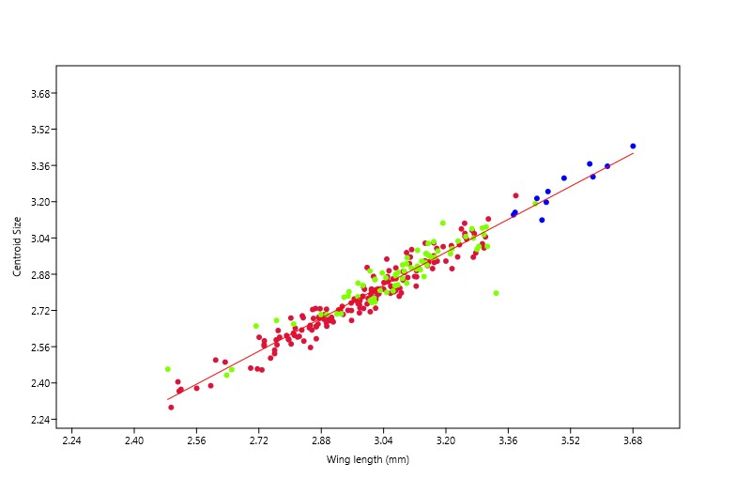
Wing length and CS regression
Legend
Amazon
Cerrado
Mata Atlantica
Confirms CS and wing length are highly correlated
Notes:
Done in PAST

Slide 10
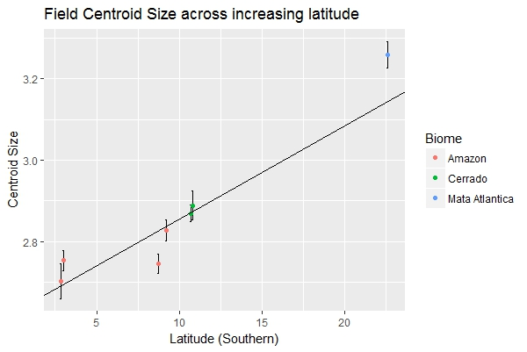
Centroid size over latitudes
Suggests support of a Bergmann cline
R^2=.2642, p<2.2e^-16
Notes:
Done in R

Slide 11
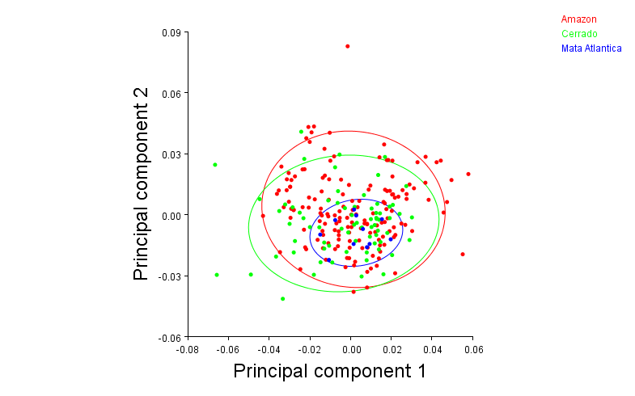
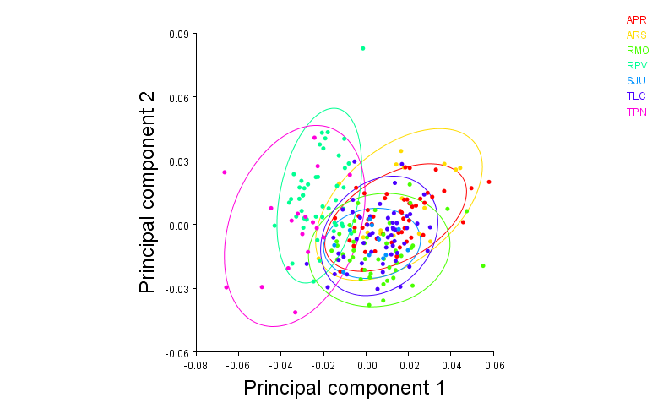
PCA’s by biome and latitude
PC1: 27.94%, PC2: 19.15%

Slide 12
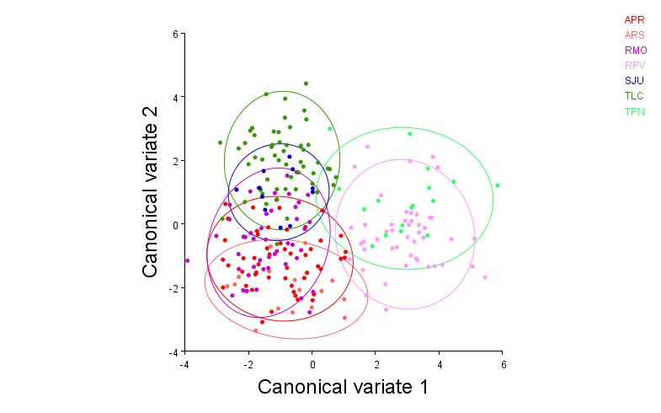
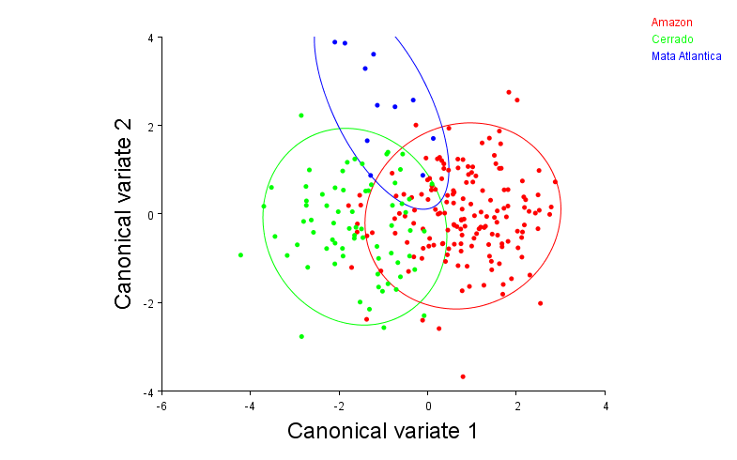
CVA by biome and latitude (10,000 permutations)
CV1: 53.69%, CV2: 27.66%
CV1: 80.71%, CV2: 19.29%

Slide 13
CVA by biome and latitude (10,000 permutations)
Bolded have p-values<0.001
Mahalanobis distances among groups:
 | APR | ARS | RMO | RPV | SJU | TLC
ARS | 1.7895
RMO | 1.8308 | 2.5093
RPV | 4.1091 | 4.4283 | 4.5022
SJU | 3.4508 | 4.1384 | 2.977 | 4.9272
TLC | 3.1466 | 4.2208 | 2.9916 | 4.5649 | 3.014
TPN | 4.8761 | 5.0438 | 4.8565 | 2.7394 | 4.8598 | 4.5795
Procrustes distances among groups:
 | APR | ARS | RMO | RPV | SJU | TLC
ARS | 0.0116
RMO | 0.0186 | 0.0241
RPV | 0.0384 | 0.0399 | 0.0393
SJU | 0.0258 | 0.0306 | 0.0203 | 0.0393
TLC | 0.0184 | 0.0264 | 0.0176 | 0.0361 | 0.0179
TPN | 0.0495 | 0.0515 | 0.0429 | 0.023 | 0.0401 | 0.0424
Mahalanobis distances among groups:
 | Amazon | Cerrado
Cerrado | 2.4605
Mata Atlantica | 3.1149 | 2.8236
Procrustes distances among groups:
 | Amazon | Cerrado
Cerrado | 0.0146
Mata Atlantica | 0.0227 | 0.0173

Slide 14
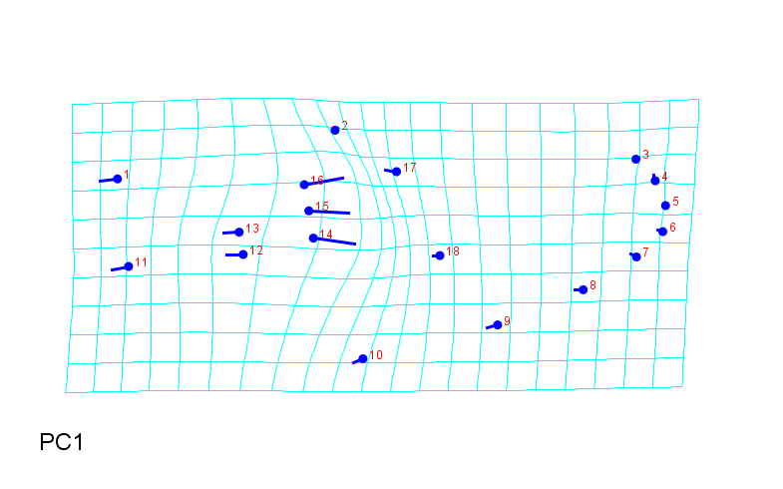
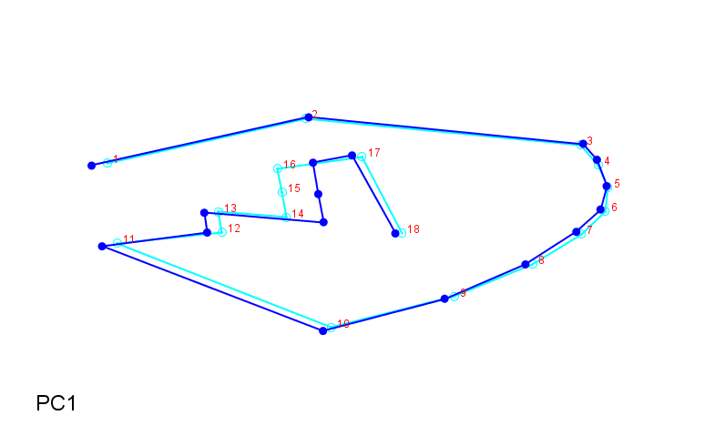
Field wing shape
Notes:
From PCA of all in Morphoj

Slide 15
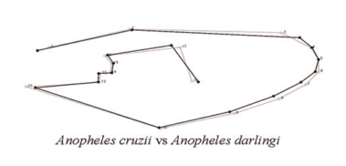
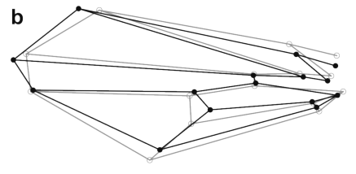
Wireframe question
Should I do this curve outline?
Or this with wing shape connections?
Wilke (2016)
Klingenberg (2013)

Slide 16

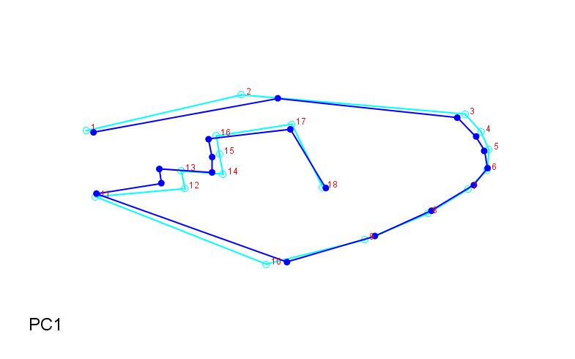
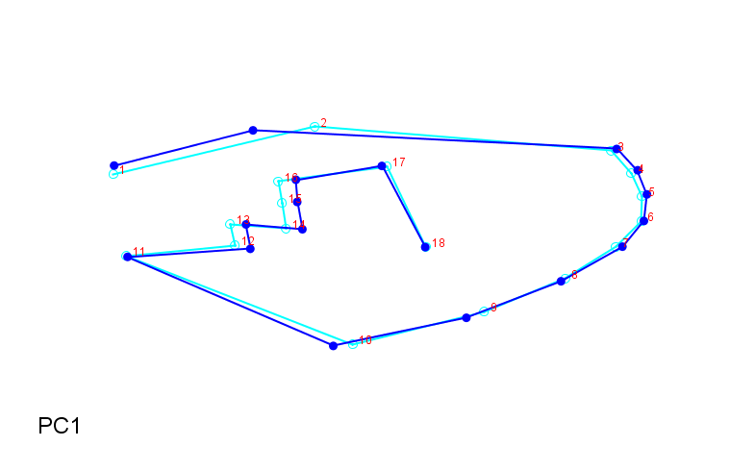
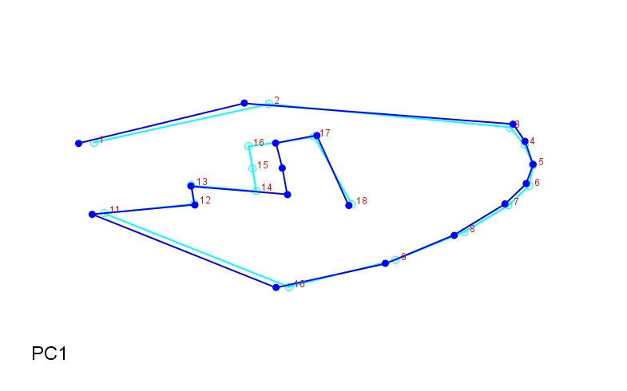
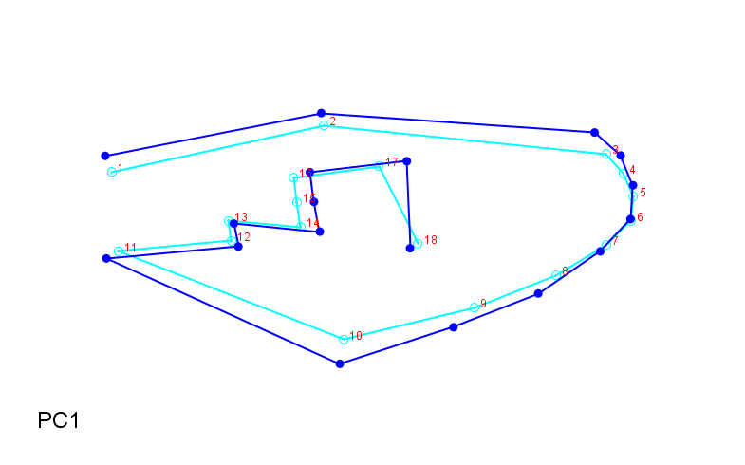
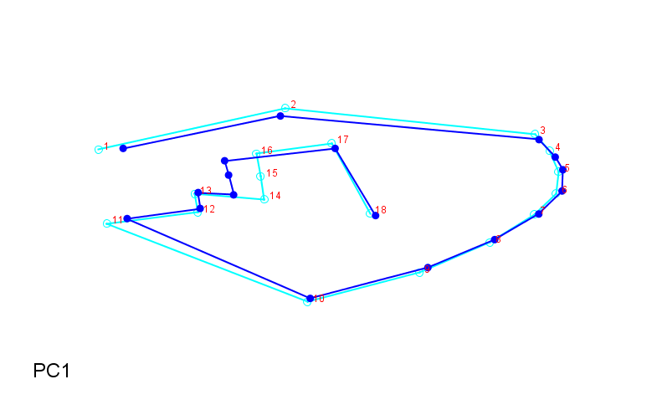
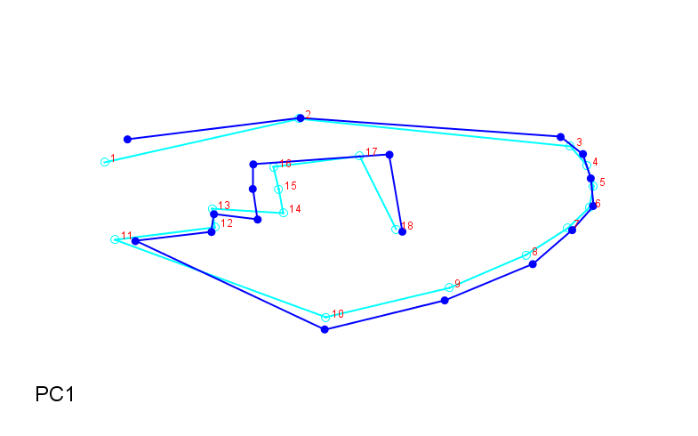
Field wing shapes by latitude
ARS
RPV
TPN
APR
RMO
TLC
SJU

